Slide 1

Ecommerce Ecosystem
Sizhe Hu
Ziyi Xiang
Sicheng Zhou

Slide 2
Problem Statement
The Ecommerce ecosystem is used for managing the network of system with the functions of buying and selling goods electronically, combined with delivering, replenishing and financing solutions.
The Ecommerce ecosystem solves the issue of inaccessibility to goods from the Buyer side and the problem of scarce sales channel from the Seller side.
The Ecommerce ecosystem alleviates the issue by matching the buyer and seller parties and ensuring the smooth functioning of the delivery, finance and factory enterprises in the system.

Slide 3

Ecommerce Ecosystem
The Ecommerce Ecosystem is built between multiple enterprises joined together: Buyer Enterprise, Seller Enterprise, Delivery Enterprise, Finance Enterprise and Factory Enterprise.
The Ecommerce ecosystem is expandable at the global level:
Cross-border ecommerce
solutions

Slide 4
Contribution
Sizhe Hu
Purchase,Sales,Factory Enterprise
Ziyi Xiang
Delivery Enterprise
Sicheng Zhou
Finance Enterprise

Slide 5
Enterprises
Purchase Enterprise: Purchase of goods
Sales Enterprise: Sale of goods
Delivery Enterprise: Delivery of goods
Finance Enterprise: Payment solutions
Factory Enterprise: Stock replenishment

Slide 6
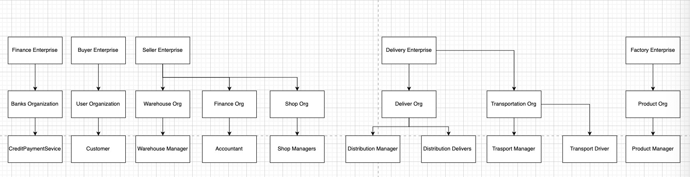
Model

Slide 7
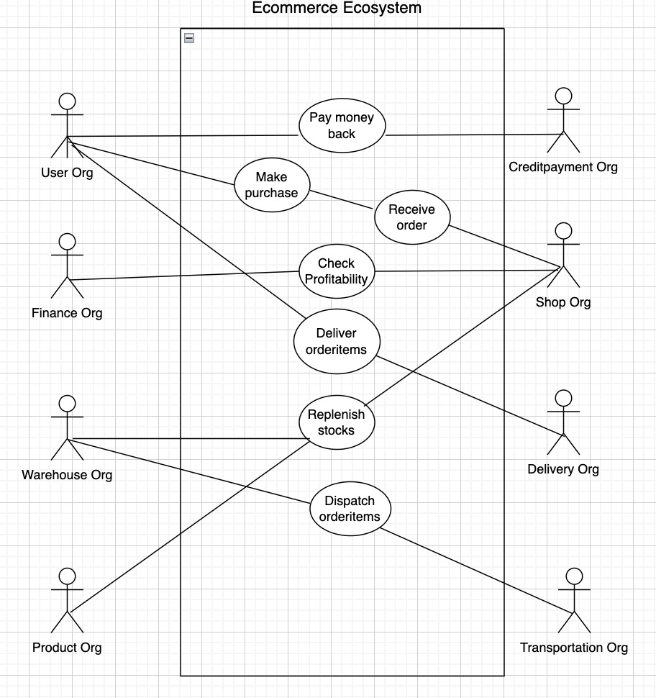
Use Cases

Slide 8
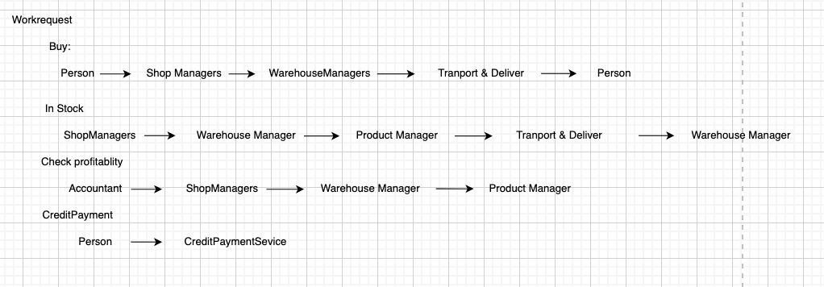
Design

Slide 9
Implementation technique
Database: DB4O
The use of work requests to manage the communication between enterprise and organization

